Slide 1
Tips For Facilitating A Live meeting to engage students

Slide 2
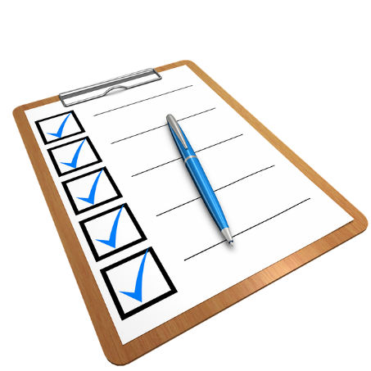
Prior To The Meeting
Send meeting connection requirements information and any materials or presentations that will be presented during the meeting a week in advance
Send a meeting agenda 1-2 days in advance, and walk through the agenda at the beginning of the meeting.
Develop engaging materials. Sneak in some surprises to keep audience interested.
Use pictures or slides (maybe even music!) during any breaks.
Create a checklist of meeting to do’s.

Slide 3
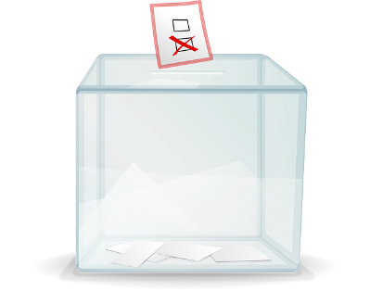
Prior To The Meeting
Let them know the basics of participation such as how to “raise their hand”, how to mute and unmute, and how to participate in chat.
Let everyone introduce themselves, if a small group.
Remind audience of the purpose of the meeting
Come up with Icebreakers activities
Plan staggered interactions throughout the meeting, such as reactions and polling, to maintain student engagement. Any polling questions should be created before the session.

Slide 4
Introductory Meeting
Consider doing a short introductory session with the purpose of ensuring students are familiar with using all of the meeting tools before your first real meeting.
Explain the student expectations in a virtual meeting setting, such as:
The chat should be used to ask topic-focused questions.
Students should only use the reactions feature when directed to.
Microphones/webcams need to remain off.
Students can use the ‘Raise Hand’ feature to indicate when they have a question.
Let students introduce themselves via webcam if it is a small group, to share where they are based, why they are taking the course and an interesting fact about themselves.

Slide 5
During The Meeting
If using a webcam:
Check your background is free from distractions.
Place your laptop at a comfortable height.
Consider using the webcam for the meeting introduction and for physical demonstrations, but turn it off for the rest of the meeting as this will save bandwidth.
Do an icebreaker activity at the beginning of the
meeting

Slide 6
During The Meeting
Be engaging
Ask questions that you want a response to.
Stop a lecture 10 minutes in and do something else to break it up
Use polling for knowledge check questions after a particular topic has been discussed to ensure students understand content.
Use reactions as a ‘check in’ to see how students are coping with new concepts.
Use reactions or polling to gauge whether students can relate to the topic being discussed or have used a particular theory in practice.

Slide 7
During The Meeting
Call on people. Getting everyone to participate without talking over each other is one of the more challenging aspects of running a virtual meeting. To forestall this, we recommend periodically calling on individuals to speak, even by virtually “going around the table”
Encourage discussion through the chat window, but ensure strategies are in place for managing large groups of students (i.e. over 30 students).
Enlist a few trustworthy students or tutors to respond to questions on your behalf.
Enlist someone to privately message you, through the chat with any questions that were not answered or missed.

Slide 8
During The Meeting
Encourage verbal student responses and questions.
Have students to use the 'raise hand' feature to manage students wanting to speak to avoid any interruptions.
Refer to students by name over the microphone when addressing their question or idea to ensure students feel appreciated for contributing, and to encourage participation.
Use breakout rooms to facilitate group activities or discussions. As the meeting host, you can join different breakout rooms to check in on students.
As the host, you can send chat messages to breakout rooms, such as time warnings or instructions.
If you pause the meeting recording (i.e. if students go into breakout rooms), verbally say you are about to pause the recording to avoid confusion for students who watch the recording. Make sure your restart the recording when ready.

Slide 9
Post Meeting
Administer an assessment/quiz to see if students were paying attention during the meeting.
If not sent out before the meeting, send out any files that were discussed during the meeting.
Send out meeting notes if any were taken.
Send out a brief survey to get students opining on how the meeting went (i.e.; what went wrong, what could have gone better, or any improvements that could be made).

Slide 10
Tips For Facilitating A Live meeting to engage students

